Slide 1
Lecture 9- Effective Business Models
Barringer Chapter 6

Slide 2

Ba 260 Lecture 9
Google
Focus on the user and all else will follow.
It’s best to do one thing really, really well.
Fast is better than slow.
Democracy on the web works.
You don’t need to be at your desk to need an answer.
You can make money without doing evil.
There’s always more information out there.
The need for information crosses all borders.
You can be serious without a suit.
Great just isn’t good enough.

Slide 3

Ba 260 Lecture 9
Che Guevera
The revolution is not an apple that falls when it is ripe. You have to make it fall.
Anonymous
“We are Anonymous. We are Legion. We do not forgive. We do not forget. Expect us.”
Oceania
"War is peace. Freedom is slavery. Ignorance is strength."

Slide 4

Ba 260 Lecture 9
NSA
Mission
The National Security Agency/Central Security Service (NSA/CSS) leads the U.S. Government in cryptology that encompasses both Signals Intelligence (SIGINT) and Information Assurance (IA) products and services, and enables Computer Network Operations (CNO) in order to gain a decision advantage for the Nation and our allies under all circumstances.
Our Vision
Global Cryptologic Dominance through Responsive Presence and Network Advantage.
Our Values
We will protect national security interests by adhering to the highest standards of behavior.

Slide 5

Ba 260 Lecture 9
Nordstrom's
In store or online, wherever new opportunities arise, Nordstrom works relentlessly to give customers the most compelling shopping experience possible. The one constant? John W. Nordstrom's founding philosophy: offer the customer the best possible service, selection, quality and value.

Slide 6

Ba 260 Lecture 9
Mc Donalds
Good Food
Good People
Good Neighbor

Slide 7
Ba 260 Lecture 9
What is a Business Model?
Model
A model is a plan or diagram that’s used to make or describe something.
Business Model
A firm’s business model is its plan or diagram for how it competes, uses its resources, structures its relationships, interfaces with customers, and creates value to sustain itself on the basis of the profits it generates.
The term “business model” is used to include all the activities that define how a firm competes in the marketplace.

Slide 8
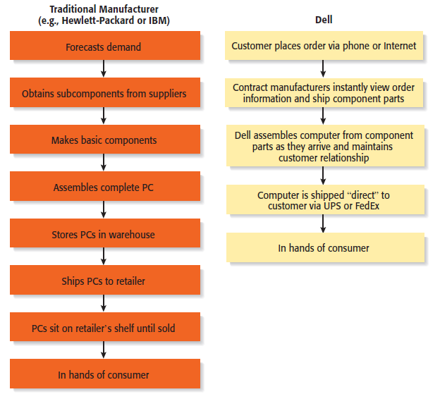
Ba 260 Lecture 9
Dell’s Business Model
Beyond Its Own Boundaries
It’s important to understand that a firm’s business model takes it beyond its own boundaries.
Almost all firms partner with others to make their business models work.
In Dell’s case, it needs the cooperation of its suppliers, customers, and many others to make its business model work.

Slide 9
Ba 260 Lecture 9
The Importance of Business Models
Having a clearly articulated business model is important because it does the following:
Serves as an ongoing extension of feasibility analysis. A business model continually asks the question, “Does this business make sense?”
Focuses attention on how all the elements of a business fit together and constitute a working whole.
Describes why the network of participants needed to make a business idea viable are willing to work together
Articulates a company’s core logic to all stakeholders, including the firm’s employees.

Slide 10
Ba 260 Lecture 9
Diversity of Business Models
There is no standard business model for an industry or for a target market within an industry.
However, over time, the most successful business models in an industry predominate.
There are always opportunities for business model innovation.

Slide 11
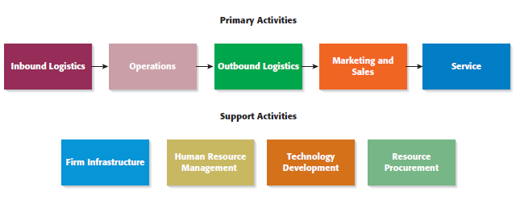
Ba 260 Lecture 9
How Business Models Emerge
The Value Chain
The value chain is the string of activities that moves a product from the raw material stage, through manufacturing and distribution, and ultimately to the end user.
By studying a product’s or service’s value chain, an organization can identify ways to create additional value and assess whether it has the means to do so.
Value chain analysis is also helpful in identifying opportunities for new businesses and in understanding how business models emerge.

Slide 12

Ba 260 Lecture 9
The Value Chain (continued)
Entrepreneurs look at the value chain of a product or a service to pinpoint where the value chain can be made more effective or to spot where additional “value” can be added.
This type of analysis may focus on:
A single primary activity such as marketing and sales.
The interface between one stage of the value chain and another, such as the interface between operations and outgoing logistics.
One of the support activities, such as human resource management

Slide 13
Ba 260 Lecture 9
Potential Fatal Flaws in Business Models
Two fatal flaws can render a business model untenable from the beginning:
A complete misread of the customer
Utterly unsound economics

Slide 14
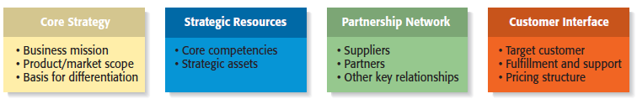
Ba 260 Lecture 9
Components of a Business Model

Slide 15
Ba 260 Lecture 9
Core Strategy
The first component of a business model is the core strategy, which describes how a firm competes relative to its competitors.
Primary Elements of Core Strategy
Mission statement
Product/market scope
Basis for differentiation

Slide 16
Ba 260 Lecture 9
Core Strategy
Primary Elements of Core Strategy
Mission Statement- A firm’s mission, or mission statement, describes why it exists and what its business model is supposed to accomplish.
Product/Market Scope- A company’s product/market scope defines the products and markets on which it will concentrate.
Basis of Differentiation- It is important that a new venture differentiate itself from its competitors in some way that is important to its customers. If a new firm’s products or services aren’t different from those of its competitors, why should anyone try them?

Slide 17
Ba 260 Lecture 9
Strategic Resources
A firm is not able to implement a strategy without resources, so the resources a firm has affect its business model substantially.
For a new venture, its strategic resources may initially be limited to the competencies of its founders, the opportunity they have identified, and the unique way they plan to serve their market.
The two most important strategic resources are:
A firm’s core competencies
Strategic assets

Slide 18
Ba 260 Lecture 9
Strategic Resources
Primary Elements of Strategic Resources
Core Competencies- A core competency is a resource or capability that serves as a source of a firm’s competitive advantage. Examples include Sony’s competence in miniaturization and Dell’s competence in supply chain management.
Strategic Assets- Strategic assets are anything rare and valuable that a firm owns. They include plant and equipment, location, brands, patents, customer data, a highly qualified staff, and distinctive partnerships.

Slide 19
Ba 260 Lecture 9
Importance of Strategic Resources
New ventures ultimately try to combine their core competencies and strategic assets to create a sustainable competitive advantage.
This factor is one that investors pay close attention to when evaluating a business.
A sustainable competitive advantage is achieved by implementing a value-creating strategy that is unique and not easy to imitate.
This type of advantage is achievable when a firm has strategic resources and the ability to use them.

Slide 20
Ba 260 Lecture 9
Partnership Network
A firm’s partnership network is the third component of a business model. New ventures, in particular, typically do not have the resources to perform key roles.
In most cases, a business does not want to do everything itself because the majority of tasks needed to build a product or deliver a service are not core to a company’s competitive advantage.
A firm’s partnership network includes:
Suppliers
Other key relationships

Slide 21
Ba 260 Lecture 9
Partnership Network
Primary Elements of Partnership Network
Suppliers- A supplier is a company that provides parts or services to another company. Intel is Dell’s primary suppler for computer chips, for example.
Other Key Relationships- Firms partner with other companies to make their business models work. An entrepreneur’s ability to launch a firm that achieves a competitive advantage may hinge as much on the skills of the partners as on the skills within the firm itself.

Slide 22
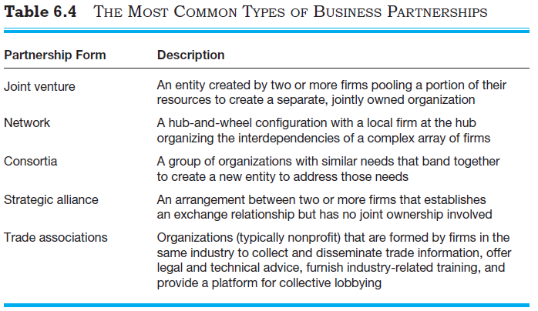
Ba 260 Lecture 9
The most common types of partnerships

Slide 23
Ba 260 Lecture 9
Customer Interface
The way a firm interacts with its customer hinges on how it chooses to compete.
For example, Amazon.com sells books over the Internet while Barnes & Noble sells through its traditional bookstores and online.
The three elements of a company’s customer interface are:
Target customer
Fulfillment and support
Pricing model

Slide 24
Ba 260 Lecture 9
Primary Elements of Customer Interface
Target Market- A firm’s target market is the limited group of individuals or businesses that it goes after or tries to appeal to
Fulfillment and Support- Fulfillment and support describes the way a firm’s product or service reaches its customers. It also refers to the channels a company uses and what level of customer support it provides.
Pricing Structure- The third element of a company’s customer interface is its pricing structure. Pricing models vary, depending on a firm’s target market and its pricing philosophy.

Slide 25
Ba 260 Lecture 9
Business Models
It is very useful for a new venture to look at itself in a holistic manner and understand that it must construct an effective “business model” to be successful.
Everyone that does business with a firm, from its customers to its partners, does so on a voluntary basis. As a result, a firm must motivate its customers and its partners to play along.
Close attention to each of the primary elements of a firm’s business model is essential for a new venture’s success.

